Slide 1
AI and logical inferences
Week 5
Dimitri Didmanidze, Michael High
Dr. McCartin-Lim

Slide 2
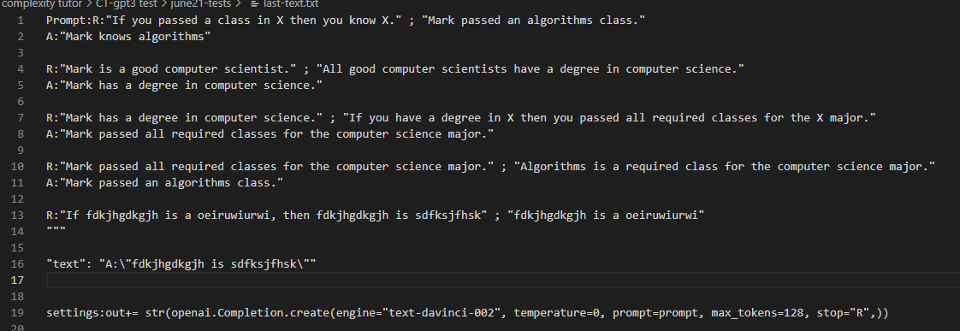
Initial Results
RECAP
GPT-3 Davinci and AI21 j1-jumbo both appear to complete basic inferences

Slide 3
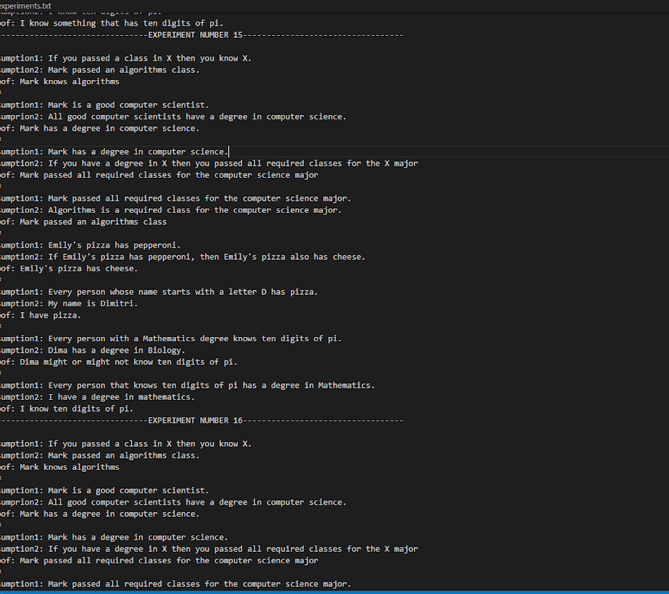
Experiments with Babbage
RECAP
Testing the feasibility of smaller models
Possibility of moving to the OPT model

Slide 4
Alternatives to GPT-3
AI21 studio’s Jurassic models
Meta’s OPT models
RECAP

Slide 5
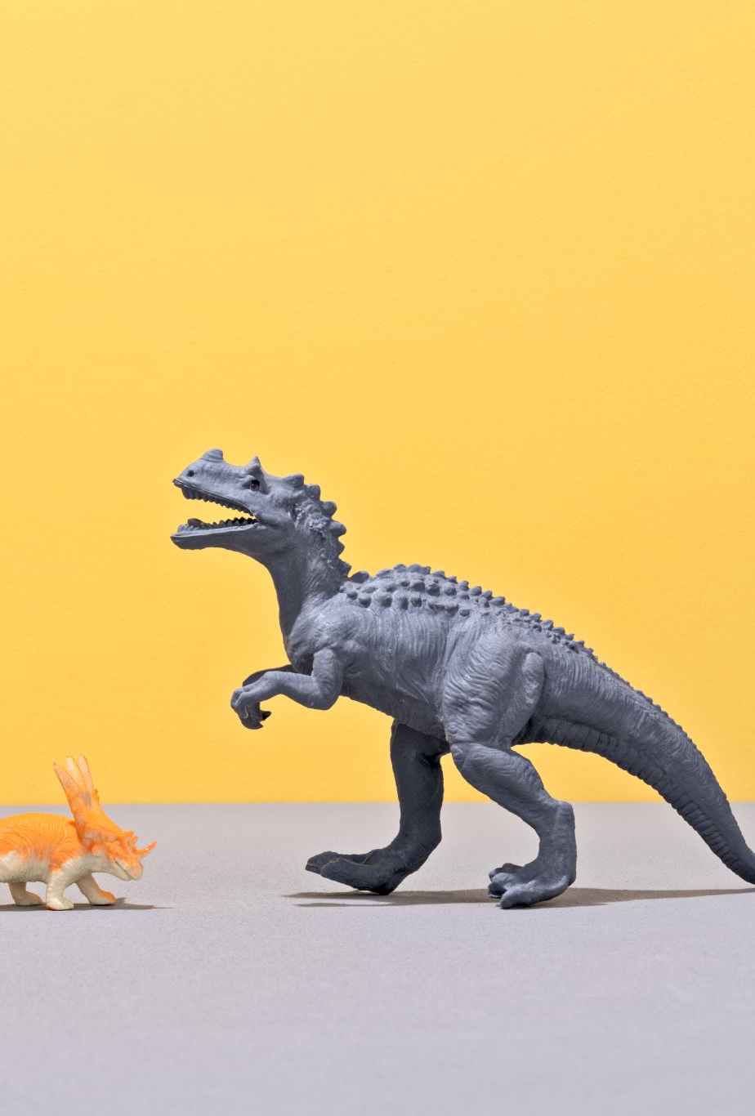
This week
Transition to Jurassic
Unification under Dimitri’s prompt formatting
Separation into inference categories based on Natural Deduction
Test Jurassic Jumbo model performance by category
OPT model – work in progress (fine-tuning?)
Jurassic models can also be fine tuned

Slide 6
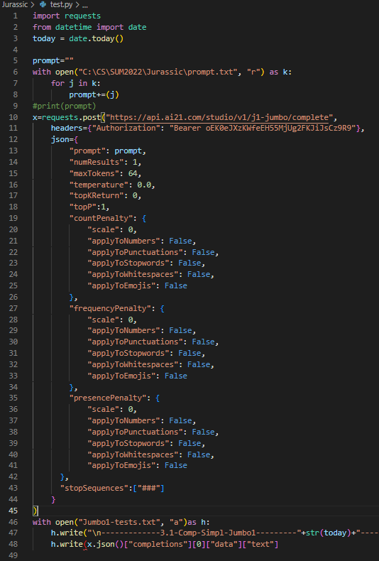
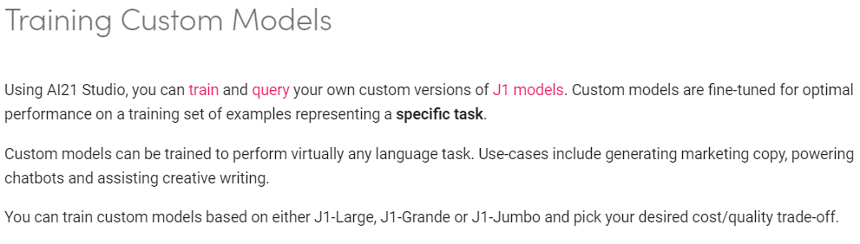
Jurassic
Still accessing an API, but more sustainable than GPT-3
Possibility of fine-tuning
Similar performance to GPT-3 models

Slide 7
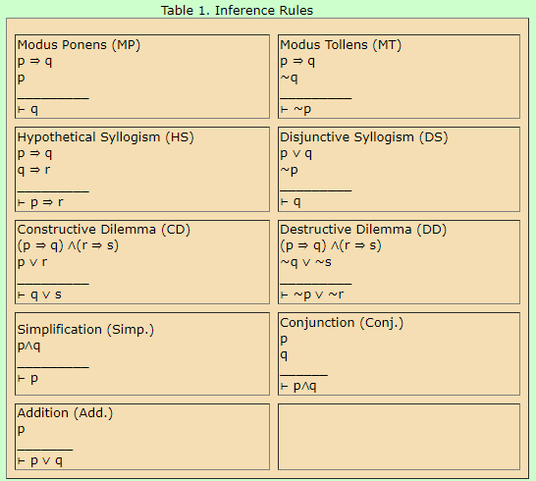
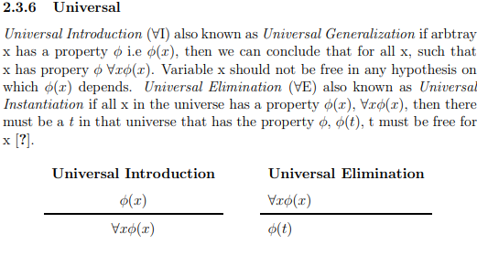
Natural deduction
A deductive system allowing the construction of proofs of tautologies in a step-by-step fashion

Slide 8
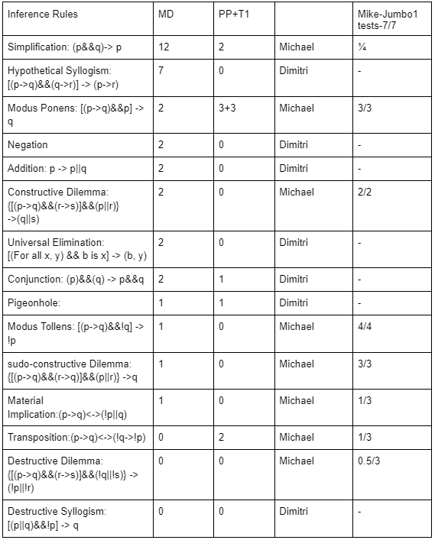
Testing by category
Strong performances vs weak performances
Reformatting of test structure
Automation of testing and prompt configuration
Possible bias created by prompt order to be solved with randomization

Slide 9
Questions?
Code examples?

